Slide 1
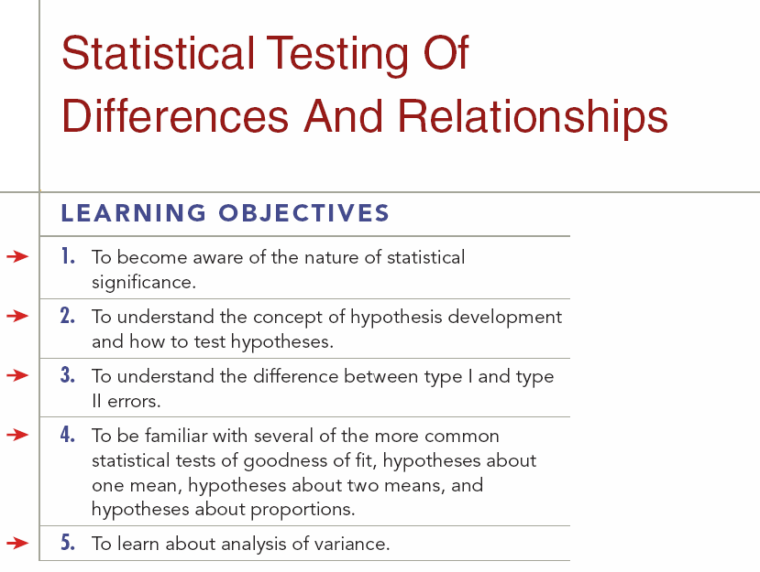

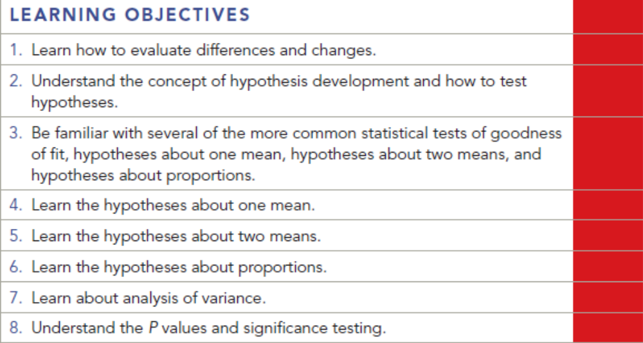
Chapter Sixteen
16-1

Slide 2
Statistical Significance
Exam Score
  Female=120
  Male=110
  Female higher than male?

Slide 3
Statistical Significance
Mathematical Differences:
  By definition, if numbers are not exactly the same, they are different. This does not, however, mean that the difference is either important or statistically significant.
Statistical Significance:
  A difference that is large enough that it is not likely to have occurred because of chance or sampling error.
16-3
Key Terms & Definitions

Slide 4
Statistical Significance
Important Differences for Managers:
  One must be able to distinguish between mathematical differences and statistically significant differences in using the data analysis in managerial decision making.
Hypothesis:
  Assumption or theory that a researcher or manager makes about some characteristic of the population under study.
16-4
Key Terms & Definitions

Slide 5
Goodness of Fit
Chi-Square Test:
Test of the goodness of fit between the OBSERVED distribution and the EXPECTED distribution of a variable.
Marketing researchers often need to determine whether there is any association between two or more variables.
16-12
Key Terms & Definitions

Slide 6
Types of Hypothesis Tests
About One Mean:
Z Test:
  Hypothesis test used for a single mean if the sample is large enough and drawn at random. Usually for samples of about 30 and above.
t Test:
  Hypothesis test used for a single mean if the sample is too small to use the Z test. Usually for samples below 30.
About Two Means:
Hypothesis testing that tests the differences between groups of data.
16-13
Key Terms & Definitions

Slide 7
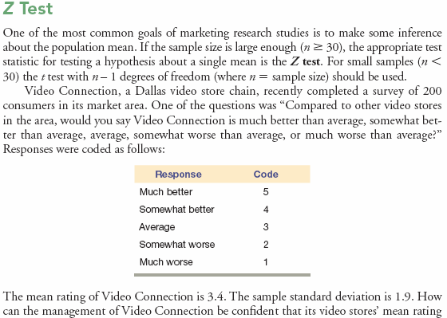
Z Test - Example
16-14
Key Terms & Definitions

Slide 8
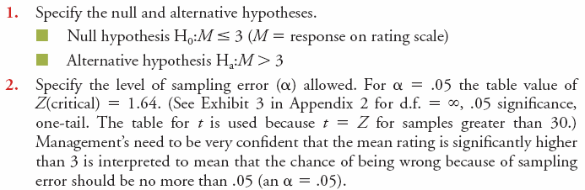
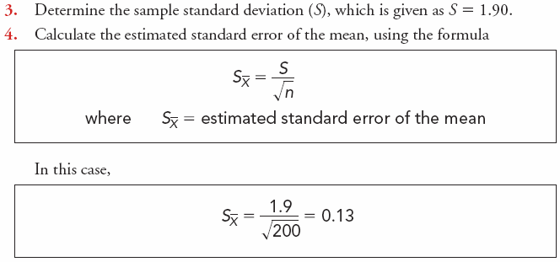
Z Test – Example
Continued
16-15
Key Terms & Definitions

Slide 9
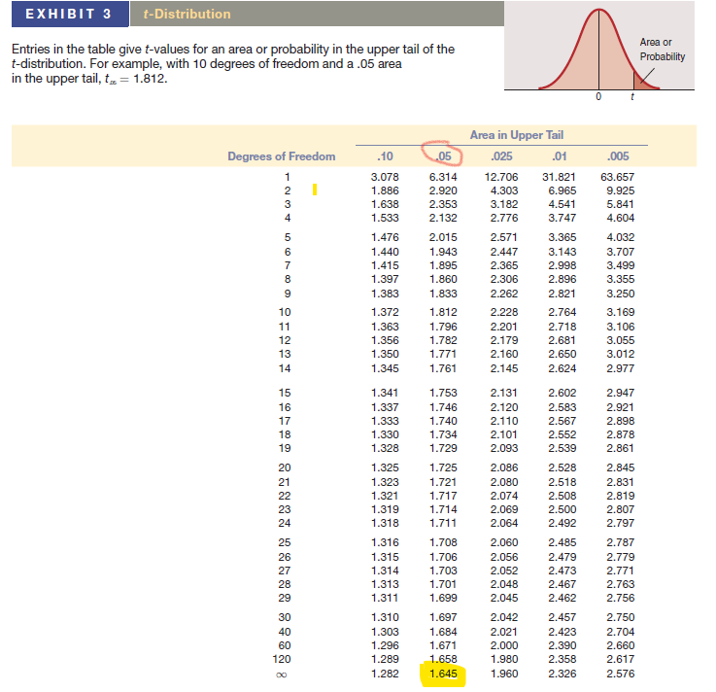

Slide 10
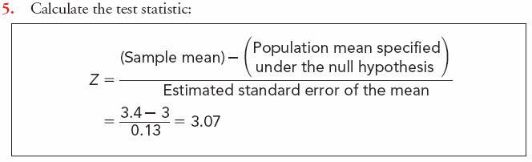
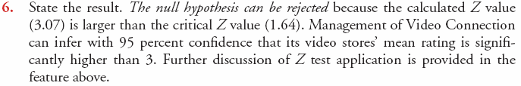
Z Test – Example
Continued
16-16
Key Terms & Definitions

Slide 11
Hypothesis About Two Means
Continued
Marketers are frequently interested in testing differences between groups. In the following example of testing the differences between two means, the samples are independent.
The management of a convenience store chain is interested in differences between the store visit rates of men and women.
Mean for Male=11.49
Mean for Female=8.51
Believing that men visit convenience stores more often than women, management collected data on convenience store visits from 1,000 randomly selected consumers. Testing this hypothesis involves the following steps:

Slide 12
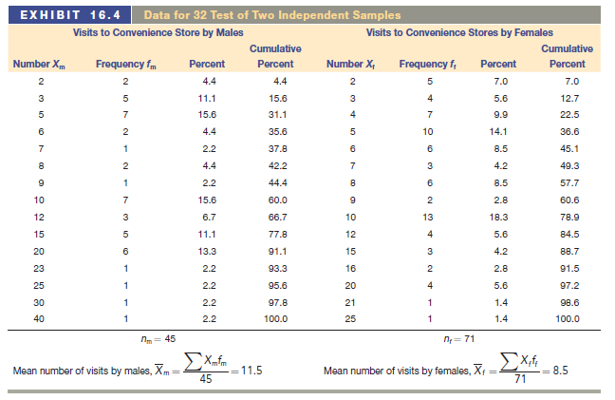
Hypothesis About Two Means
Continued

Slide 13
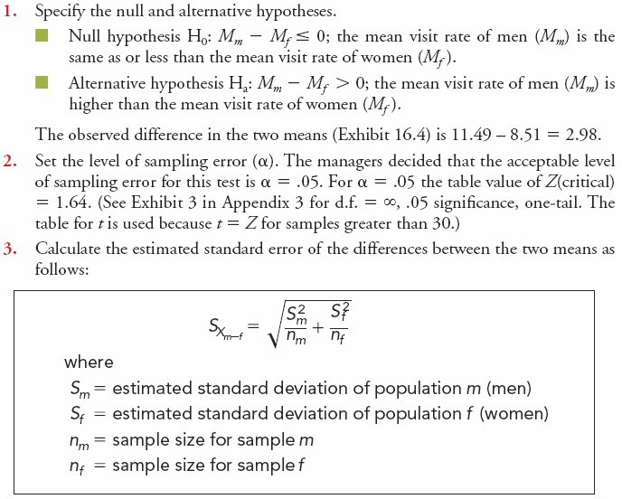
Hypothesis About Two Means - Example
Key Terms & Definitions
16-17

Slide 14
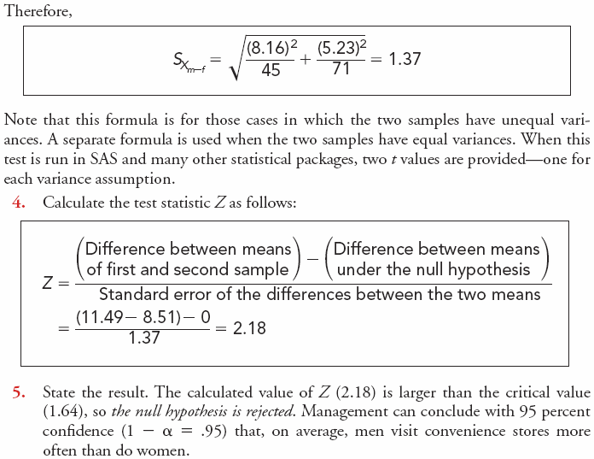
Hypothesis About Two Means
Continued
16-18

Slide 15
Hypothesis About Two Means
Continued
A child psychologist observed 8-year-old children behind a one-way mirror to determine how long they would play with a toy medical kit. The company that designed the toy was attempting to determine whether to give the kit a masculine or feminine orientation. The length of time (in minutes) the children played with the kits are shown below. Calculate the value of Z and recommend to management whether the kit should have a male or female orientation.
Sex | Time played with toy medical kit
Boys | 31 | 12 | 41 | 34 | 63 | 7 | 67 | 67 | 25 | 73 | 36 | 41 | 15
Girls | 26 | 38 | 20 | 32 | 16 | 45 | 9 | 9 | 16 | 26 | 81 | 20 | 5
16-18

Slide 16
Hypothesis About Two Means
Continued
STEP 1: Hypotheses
Ho: The difference in the mean length of time is equal to zero.
Ha: The difference in the mean length of time is non-zero.
16-18

Slide 17
Hypothesis About Two Means
Continued
STEP 2: Decide on Significance Level and Look up Appropriate Table Value
Assume an alpha of 0.05.
Since the sample size is less than 30, it is appropriate to use a t-test.
This is also a two tailed test, hence, the value from the t table for n=12 and alpha = 0.05 is 2.179
16-18

Slide 18
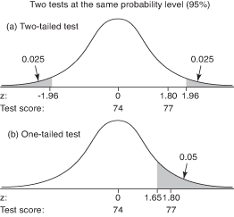

Slide 19
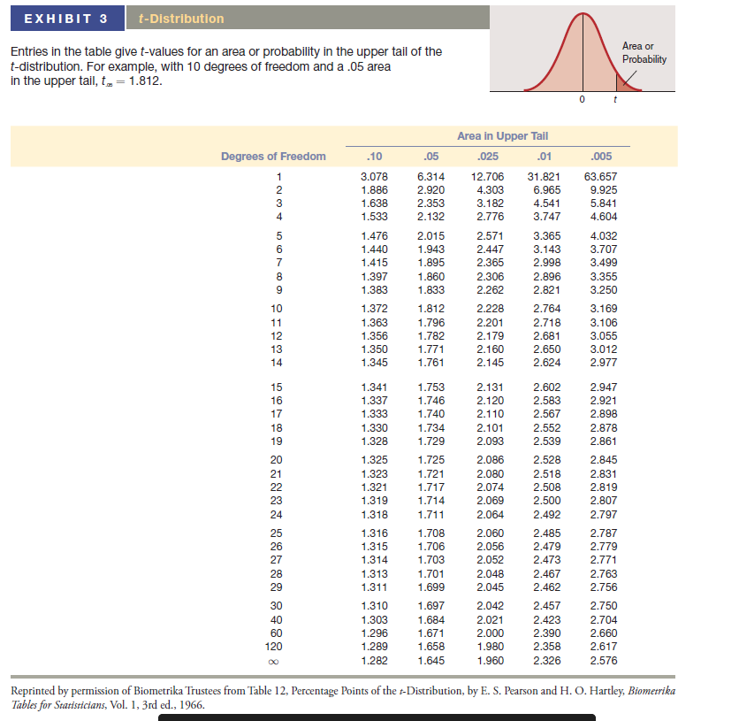

Slide 20
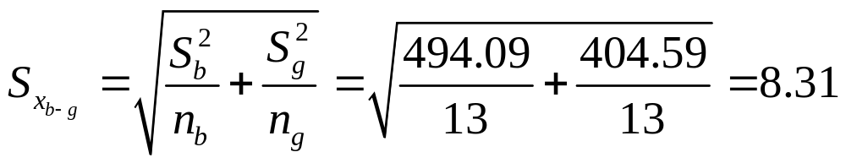
Hypothesis About Two Means
Continued
STEP 3: Calculate the Pooled Standard Error for the two samples
The mean of the boys is 39.38. The mean of the girls is 26.83. The variance for the boys was 494.09 and the variance for the girls was 404.59. Therefore, the pooled standard error is 8.31 (square root of 494.09/13 + 404.59/13).
Sex | Time played with toy medical kit |  |  |  |  |  |  |  |  |  |  |  |  | Avg. | S | S² | S²/n
Boys | 31 | 12 | 41 | 34 | 63 | 7 | 67 | 67 | 25 | 73 | 36 | 41 | 15 | 39.38 | 22.23 | 494.09 | 38.01
Girls | 26 | 38 | 20 | 32 | 16 | 45 | 9 | 9 | 16 | 26 | 81 | 20 | 5 | 26.38 | 20.11 | 404.59 | 31.12
Observ. | 1 | 2 | 3 | 4 | 5 | 6 | 7 | 8 | 9 | 10 | 11 | 12 | 13
16-18

Slide 21
Hypothesis About Two Means
Continued
STEP 4: Calculate the test statistic
The observed difference in the means is 13. Therefore the t-calculated is equal to 13/8.31 or 1.56
STEP 5: Compare Results and State Conclusion
Since the t calculated value of 1.56 is less than the t-table value of 2.179, we fail to reject the null hypothesis. No significant difference in the attention span of boys and girls was found. No recommendation can be made to management, except to perhaps take a larger sample.
16-18

Slide 22
Analysis of Variance (ANOVA)
ANOVA:
Test for the differences among the means of two or more independent samples.
When the goal is to test the differences among the means of two or more independent samples, analysis of variance (ANOVA) is an appropriate statistical tool. Although it can be used to test differences between two means, ANOVA is more commonly used for hypothesis tests regarding the differences among the means of several (C ) independent groups (where C > or = 3). It is a statistical technique that permits the researcher to determine whether the variability among or across the C sample means is greater than expected because of sampling error.
16-20
Key Terms & Definitions

Slide 23
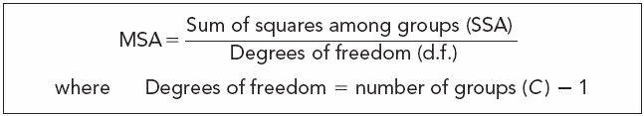
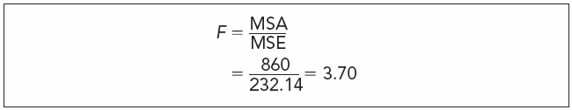

F Test
F Test:
Test of the probability that a particular calculated value could have been due to chance.
16-21
Key Terms & Definitions

Slide 24
p Values and Significance Testing
p Value:
Exact probability of getting a computed test statistic that is due to chance. The smaller the p value, the smaller the probability that the observed result occurred by chance.
16-22
Key Terms & Definitions

Slide 25
Chi-square Goodness of Fit test for Frequencies
A statistical test to determine whether some observed pattern of frequencies corresponds to an expected pattern.
  One way table—Test of one factor
  Two way table---Test of two factors

Slide 26
Chi Square Example – Test of the effectiveness of three special deals
A retail electronics chain needs to test the effectiveness of three special deals
Each deal offered for a month
Measure the effect of each deal on the number of customers visiting a test store during the time deal is on

Slide 27
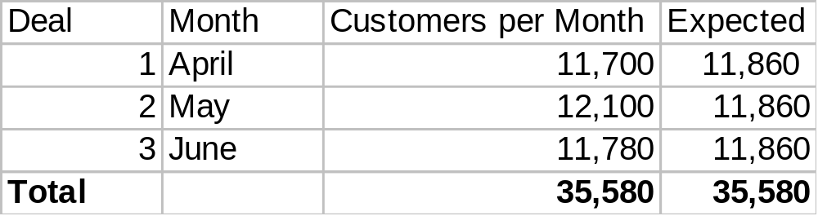
Chi-square Goodness of Fit test for Frequencies
Question: Is there a significant difference between the number of customers visiting the store under each deal?
  Ho: number of customers equal across deals
  Ha: significant difference in the no of customers visiting the store under various deals
Level of significance = .05

Slide 28
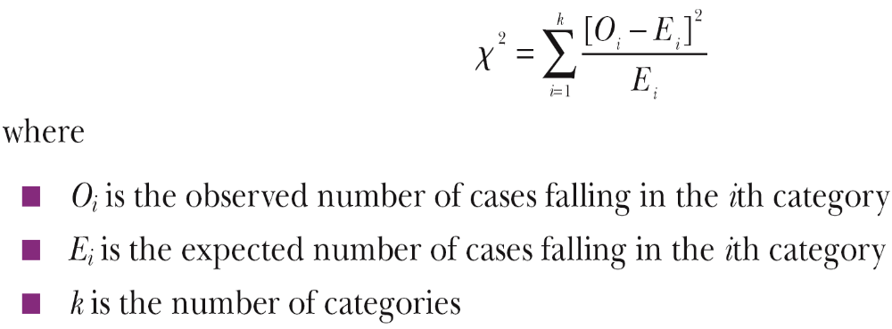
Chi-Square Goodness-of-Fit Test for Frequencies
  A statistical test to determine whether some observed pattern of frequencies corresponds to an expected pattern
  O_{i} is the observed number of cases falling in the ith category,
  E_{i} is the expected number of cases falling in the ith category, and
  k is the number of categories
Notes:
The Chi-square Goodness-of-Fit test for Frequencies is appropriate when there are groups within which frequencies are counted, and there is no order to these groups.

Slide 29
Calculate Chi-Square value
= (11,700 – 11,860)² + (12,100 – 11,860)² + (11,780 – 11,860)²
11860 11860 11860
⁼ 7.6
df = k-1=3-1=2,
Significance level= 0.05 , table value= 5.99.
Conclusion: Because observed value is higher than the table value
(7.6 > 5.99), we reject the null.

Slide 30
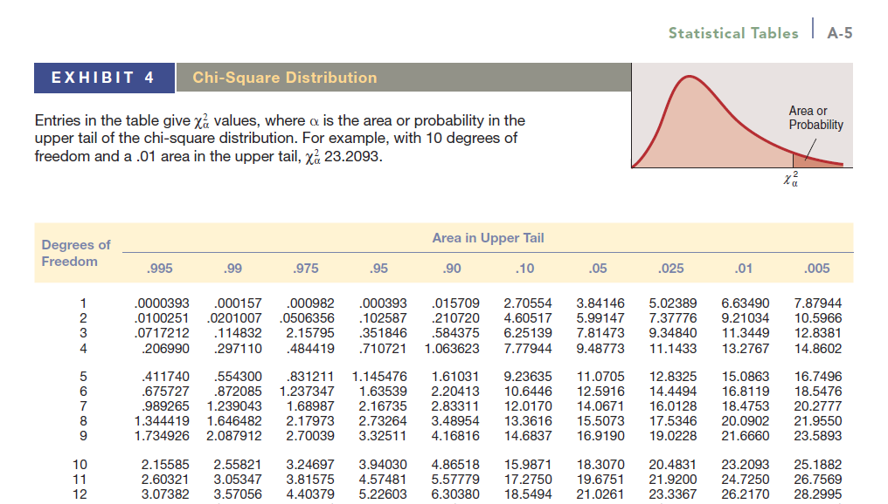

Slide 31
Univariate versus Multivariate Analysis
The chi-square test provides a method for testing the association between the row and column variables in a two-way table.
H₀ assumes that there is no association between the variables (in other words, one variable does not vary according to the other variable),
H_{a} claims that some association does exist.
  The alternative hypothesis does not specify the type of association, so close attention to the data is required to interpret the information provided by the test.

Slide 32
Analyses Involving Categorical Measures
Two-Way Cross Tabulations
  A multivariate technique used for studying the relationship between two or more categorical variables (i.e., nominal- or ordinal-level)
  Cross tabs consider the joint distribution of sample elements across variables
  It is the most used multivariate data analysis technique
Notes:
of one variable is counted at each level (category) of the other variable. This will be Illustrated in a moment.

Slide 33
Example
Your university library is concerned about student desires for library hours on Sunday morning (9:00 a.m. – 12:00 p.m.).
It has undertaken a random sample of 1,600 undergraduate students (one-half men, one half women) in each of four status levels (i.e. 400 freshmen, 400 sophomores, 400 juniors, 400 seniors.)
If the percentage of students preferring Sunday morning hours are those shown below, what conclusions can the library reach?

Slide 34
Observed Results
 | Sen | Jun | Soph | Fresh | TOTAL
Women | 70 | 53 | 39 | 26 | 188
Men | 30 | 48 | 31 | 27 | 136
TOTAL | 100 | 101 | 70 | 53 | 324

Slide 35
Step 1: Hypotheses
Ho: There is no relationship between gender and class year.
Ha: There is a significant relationship between gender and class year.
Note again:
  The null hypothesis H₀ assumes that there is no association between the variables while the alternative hypothesis H_{a} claims that some association does exist.

Slide 36
Step 2: Determine Expected Results
 | Sen | Jun | Soph | Fresh | TOTAL
Women | 70 | 53 | 39 | 26 | 188
Men | 30 | 48 | 31 | 27 | 136
TOTAL | 100 | 101 | 70 | 53 | 324
 | Sen | Jun | Soph | Fresh | TOTAL
Women | 58.02 | 58.60 | 40.62 | 30.75 | 188
Men | 41.98 | 42.40 | 29.38 | 22.25 | 136
TOTAL | 100 | 101 | 70 | 53 | 324
*Cell values calculated by multiplying each row margin total by each column margin total and dividing by the grand total, e.g., cell 1(woman x sen)=58.02=188*100/324=58.02.

Slide 37
STEP 3: Calculate Chi-Square Value
 | Sen | Jun | Soph | Fresh | TOTAL
Women | 2.47 | 0.54 | 0.06 | 0.73
Men | 3.42 | 0.74 | 0.09 | 1.02
TOTAL
Cell values calculated by taking the squared difference between the expected and observed and dividing expected,
e.g. cell 1(woman x sen)=(70-58.02)^2/58.02=2.47

Slide 38
STEP 4: Find Chi Square Table Value based on Significance Level and Degrees of Freedom
Degrees of freedom = (r-1) * (k-1) = (2-1) * (4-1) = 3
The tabulated chi square, 3 df, .05 alpha = 7.814

Slide 39
STEP 5: Compare Results and State Conclusion
The calculated chi square = 9.06
Conclusion: Calculated chi-square > Table chi-square
We can state that, of those who prefer Sunday morning hours, gender and class year are statistically dependent. That is, there is a significant difference in how gender and class status will affect the use of the library on Sunday mornings. We can expect more Senior women than any other group.

